Slide 1
LPT HELP DESK

Slide 2
Login Page:-
User has to login through the following link:-
http://inthelpdesk.logo.com.tr/
Password by Default is logo123

Slide 3
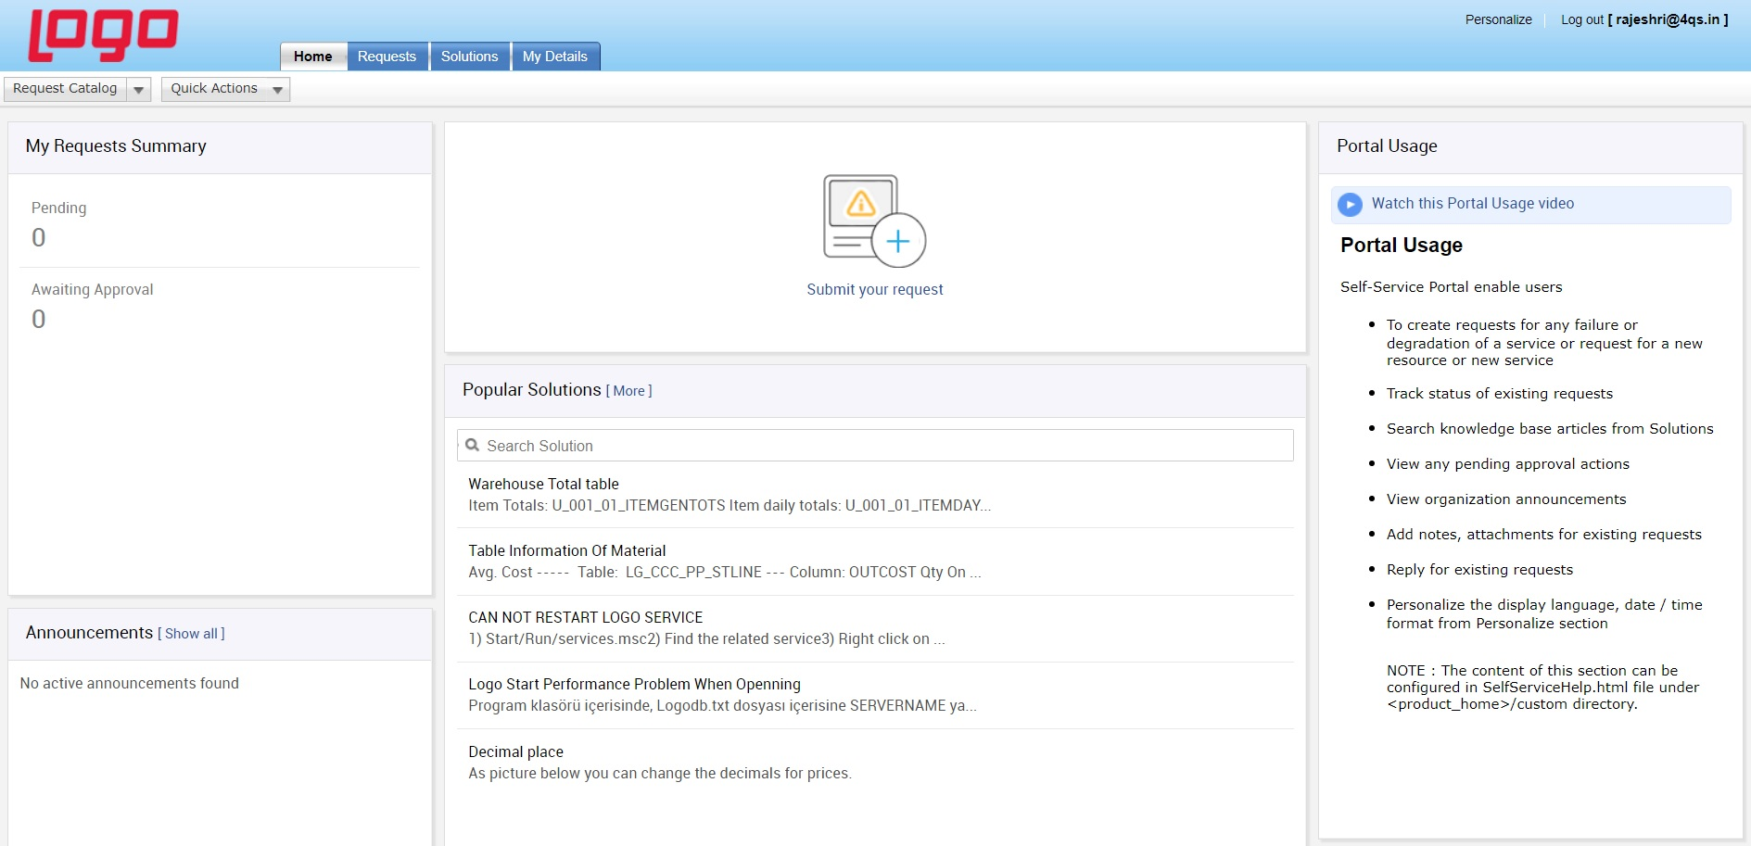
Home Page:-

Slide 4
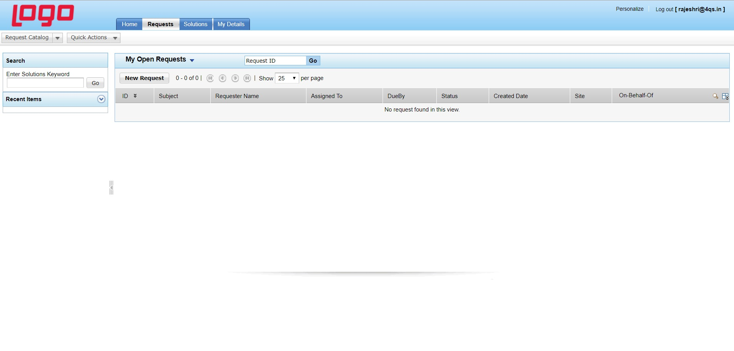
User has to click on Requests Tab from Home Page of Help Desk

Slide 5
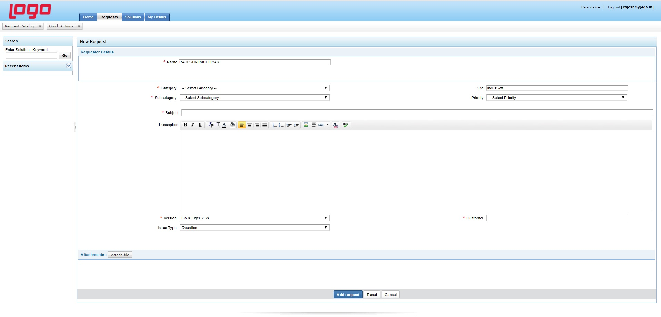
New Request Page:-

Slide 6
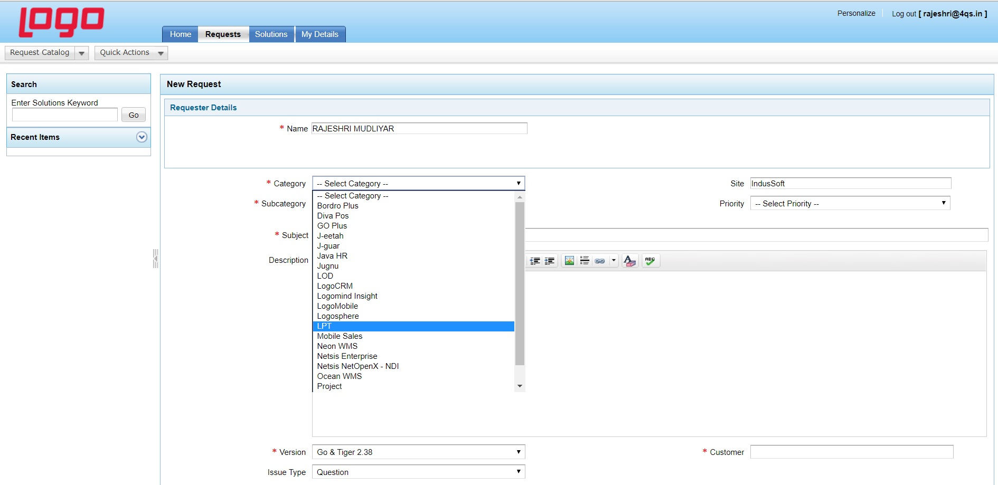
Step 1
Select LPT from Category drop down Box

Slide 7
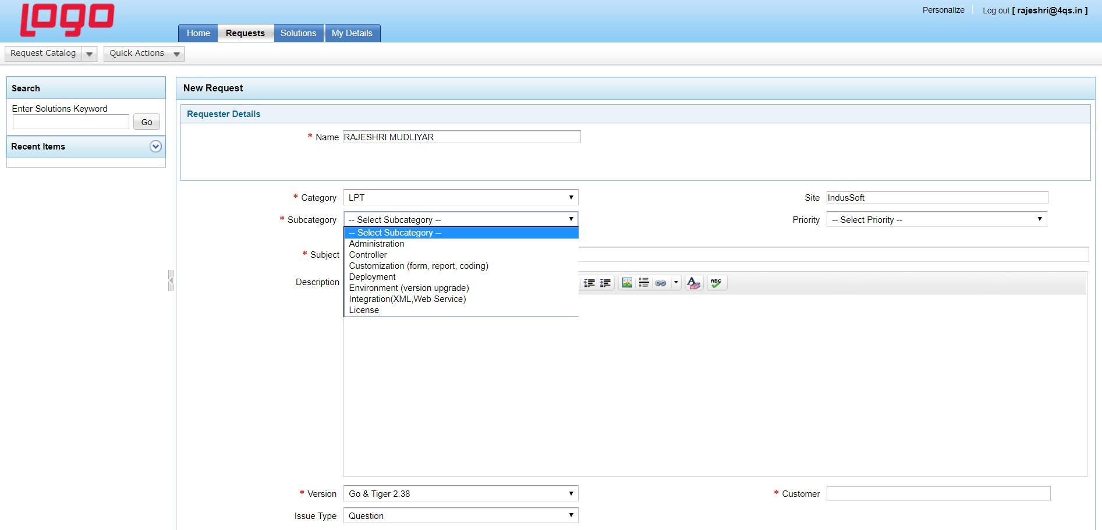
Step 2
Select any one from the Following Drop Down Box
High
Low
Medium
Normal
Select any one of the Issue from the Sub-Category Drop Down Box.

Slide 8
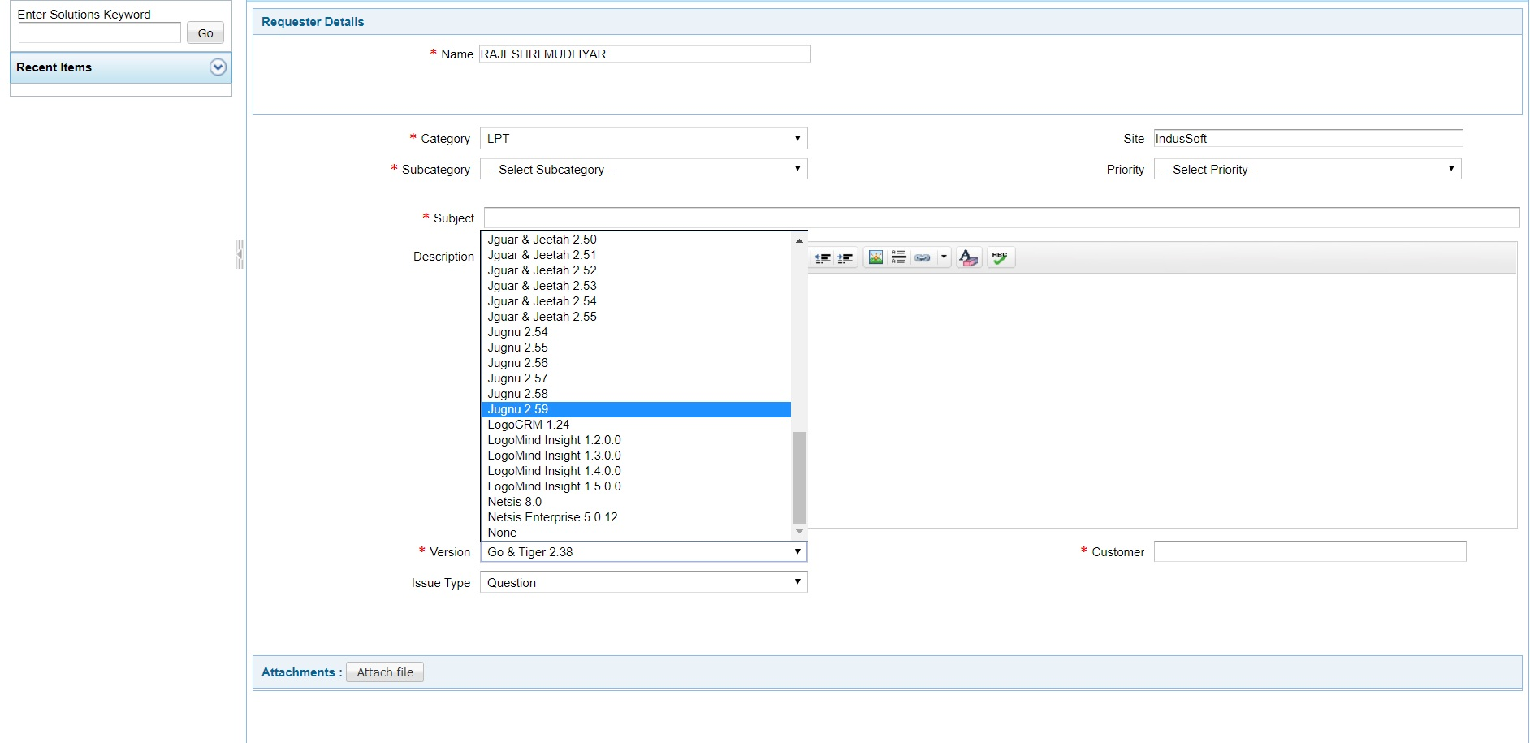
Step 3-JUGNU VERSION:-
Select Jugnu Version(Users may use different Versions) from Version Drop Down Box.

Slide 9
Step 4
Add Subject.
Provide some details of the Issue if possible for easy understanding.
Attach a screenshot of the Issue facing.
After filling up all credentials Click on Add Request.

Slide 10
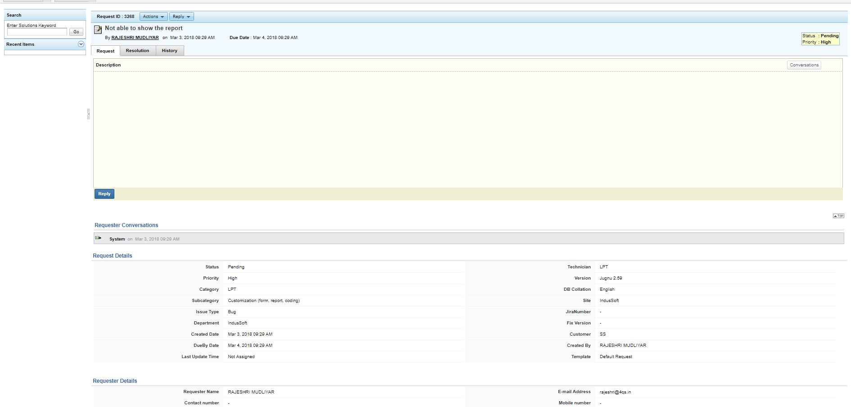
Final Notification Page:-

Slide 11
THANK YOU

